Slide 1
From Thesis to Practice: Applying Research Insights to Variational Quantum Algorithms
Francis Boabang
1
Notes:
Proactive prediction for haptic feedback in remote robotic surgery
Introduction
Remote Robotic Surgery (including overlapping surgery)
Haptic Feedback Prediction
Proactive Prediction
Related Work
Evaluation

Slide 2
Content
2024 Ph.D. Thesis Presentation
Thesis-Inspired Optimization Methods for Variational Quantum Algorithms

Slide 3
Refining Optimization Methods for Training Machine Learning Models: A Case Study in Robotic Surgical Procedures Ph.D. Thesis 2024 https://spectrum.library.concordia.ca/id/eprint/994877/6/Boabang_PhD_2024.pdf
Francis Boabang
3
Notes:
Proactive prediction for haptic feedback in remote robotic surgery
Introduction
Remote Robotic Surgery (including overlapping surgery)
Haptic Feedback Prediction
Proactive Prediction
Related Work
Evaluation

Slide 4
Content
Introduction
Contribution to the Thesis
First Contribution
Second Contribution
Conclusion of the Thesis
Limitations
Future Work

Slide 5
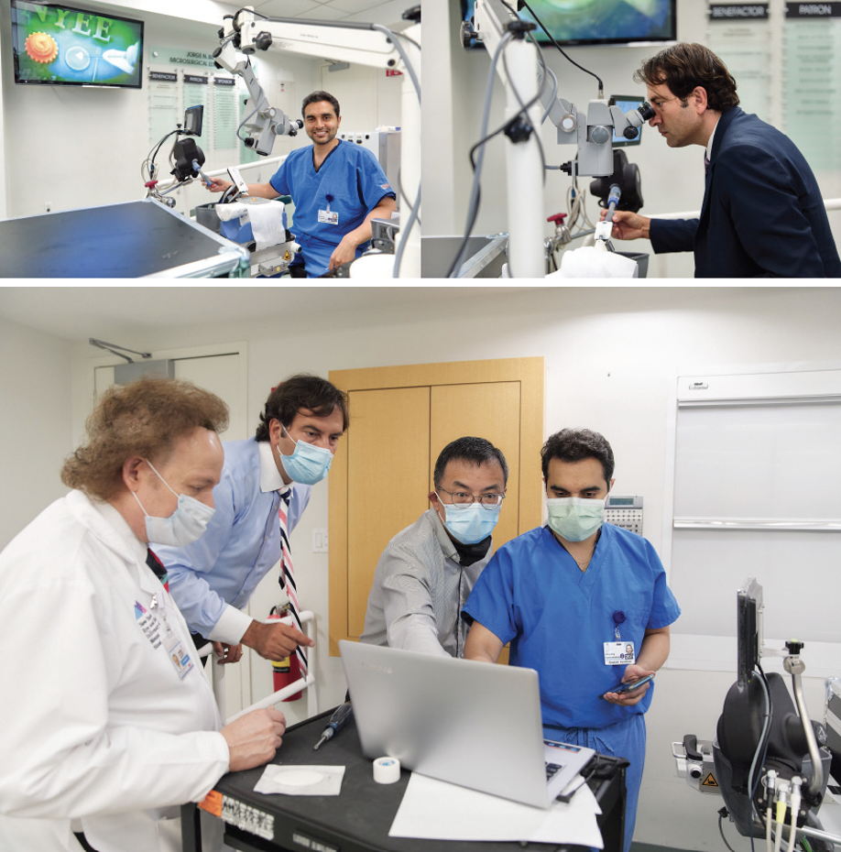


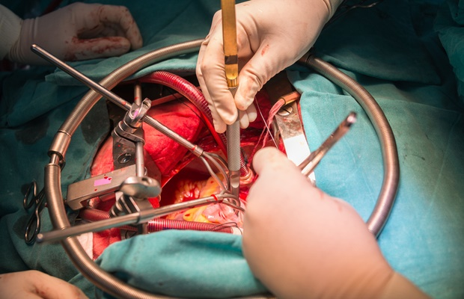
Introduction
A surgeon in a particular geographical location manipulate the surgeon console to operate on a remote patient
Benefits of Remote Robotic Surgery
Improves surgeons’ precision
Reduce patient blood loss
Ensures shorter hospital stay
Examples of Remote Robotic Surgery
Facial reconstruction surgery
Knot-tying
Suturing
Needle Passing
Trocar Insertion
Open heart surgery
Chowriappa, A., Wirz, R., Ashammagari, A.R. et al. Prediction from expert
demonstrations for safe tele-surgery. Int. J. Autom. Comput. 10, 487–497 (2013)

Slide 6
Contribution of the Thesis
An Improved Low Rank Matrix Factorization to Scale Machine Learning and Its Application to Remote Robotic Surgery [Published in IEEE TNSM]
Enhanced Stochastic Gradient Descent Algorithm for Machine Learning Training and Its Application in Remote Surgical Gesture Recognition [Under-Review at IEEE transactions on Neural Network and Learning Systems]

Slide 7
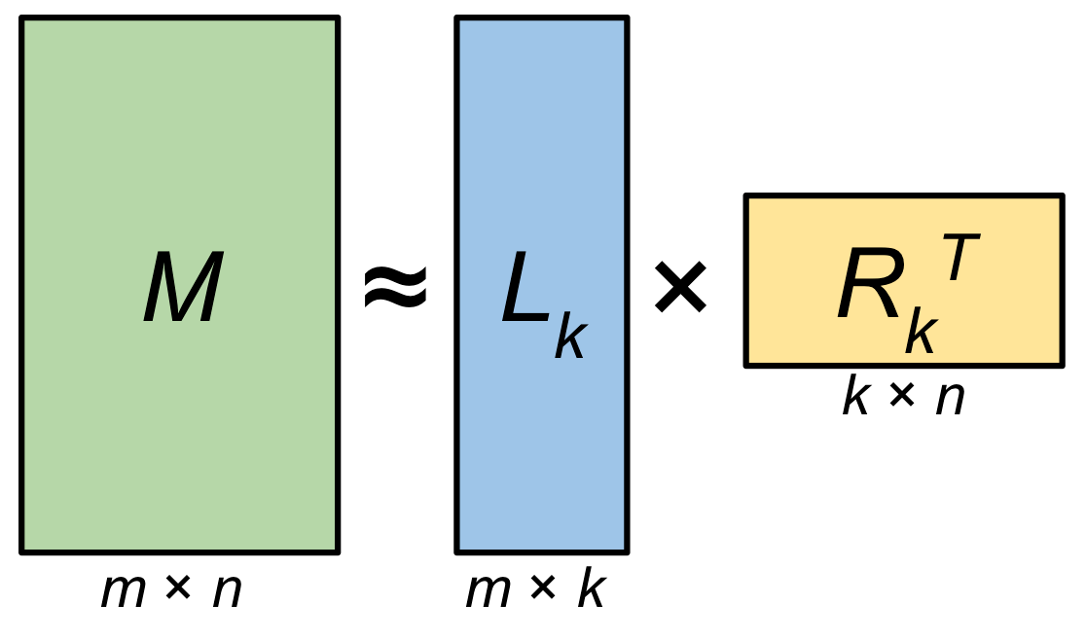
An Improved Low Rank Matrix Factorization to Scale Machine Learning and Application to Remote Robotic Surgery [Published in IEEE TNSM]
Francis Boabang, A. Ebrahimzadeh, R. Glitho, H. Elbiaze, M. Maier and F. Belqami, "A Machine Learning Framework for Handling Delayed/Lost Packets in Tactile Internet Remote Robotic Surgery," in IEEE Transactions on Network and Service Management, doi: 10.1109/TNSM.2021.3106577

Slide 8
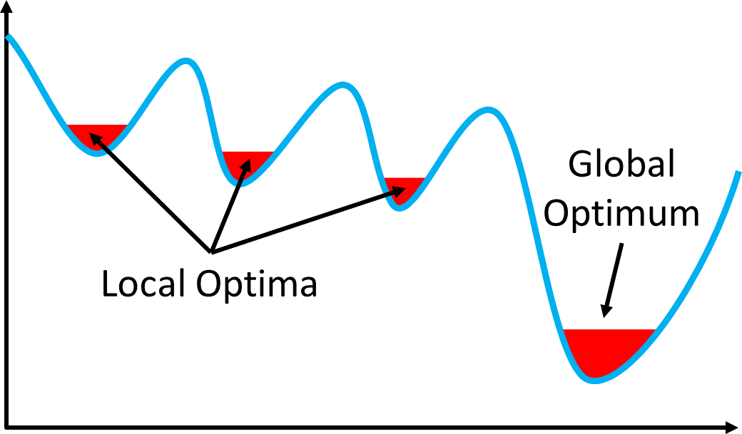
Review of Machine Learning Model Compression Techniques
Low rank and sparse matrix factorization
It can be used to scale ML methods and address delay and lost data online
Types of low rank and sparse matrix factorization
Nonconvex formulation of low rank and sparse matrix factorization
Convex formulation of low rank and sparse matrix factorization
Challenges of nonconvex formulation of low rank and sparse matrix factorization
Non-convex low-rank matrix factorization achieves higher accuracy with less computation compared to convex models
Non-convex formulations struggle to find quality solutions without good initial points
The hybrid model (convex and non-convex) can converge to quality solutions even with random initialization
The hybrid model is computationally efficient
Xiong L, Chen X, Schneider J. Direct robust matrix factorization for anomaly detection. In2011
IEEE 11th International Conference on Data Mining 2011 Dec 11 (pp. 844-853). IEEE.

Slide 9
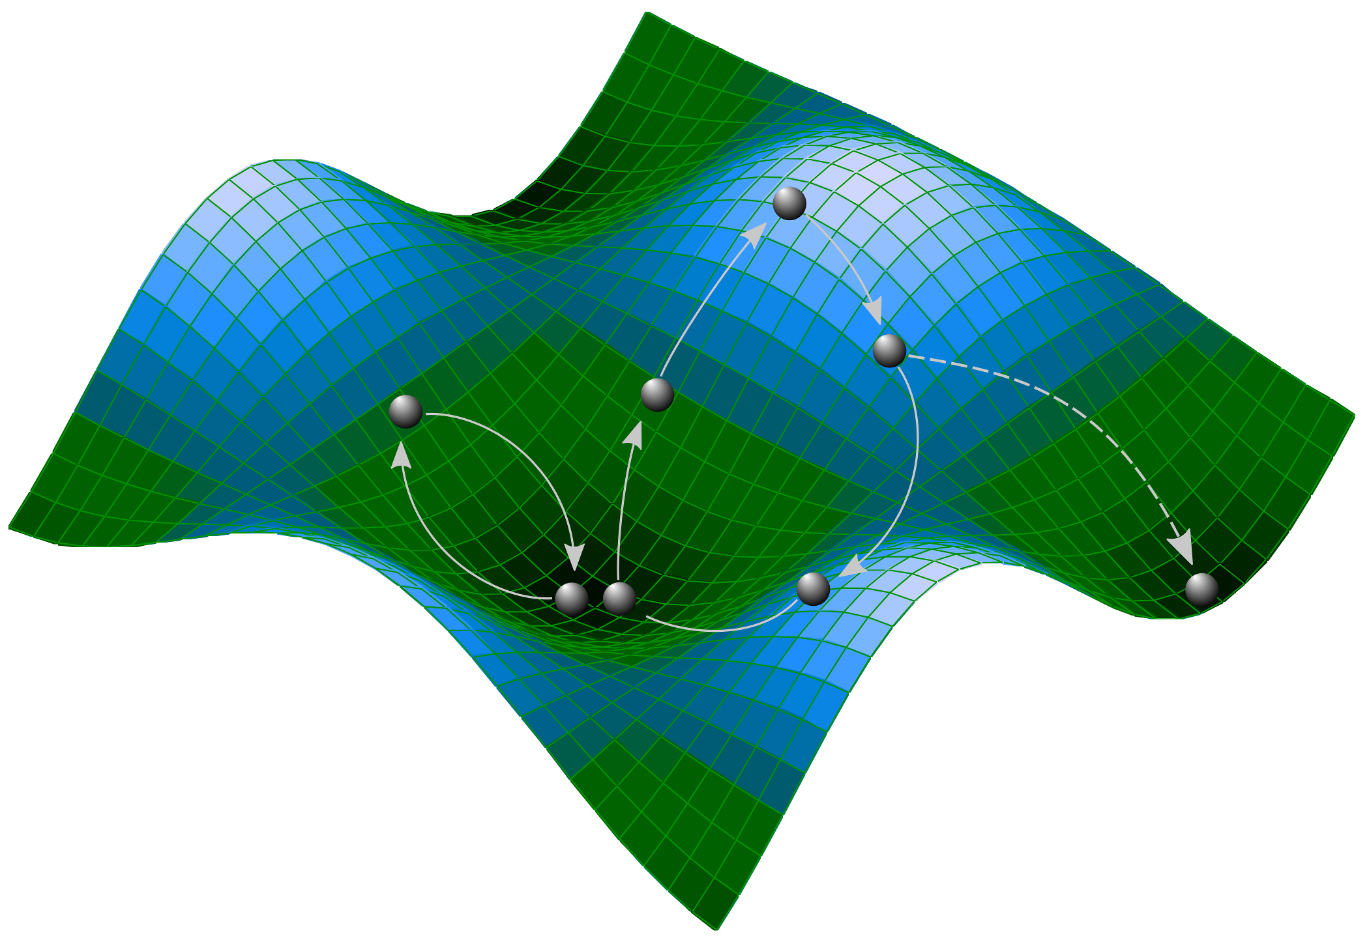
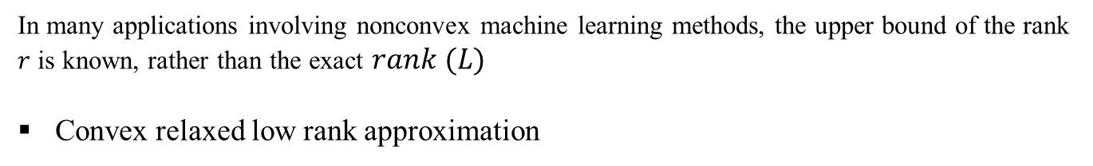
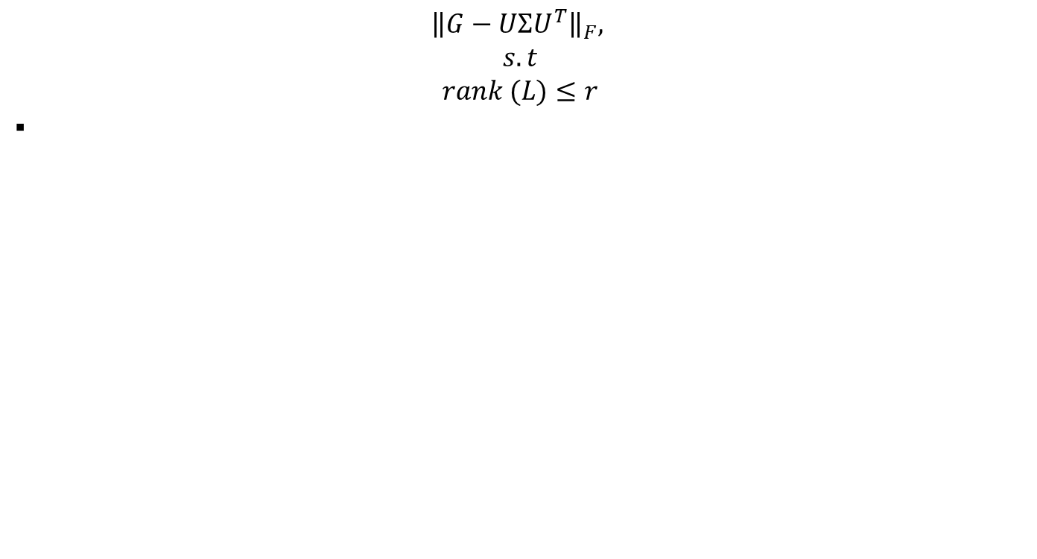
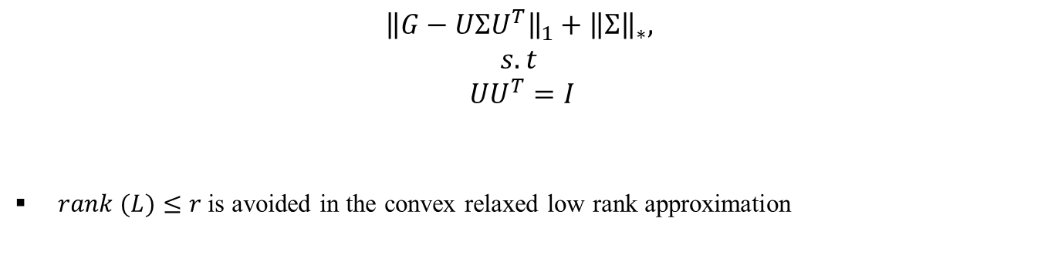
Nonconvex low-rank approximation
Overview of the Low-Rank Approximation
$${\left\|G−UΣU^{T}\right\|}_{F},$$
$$s.t$$
$$rank (L)≤r$$
In many applications involving nonconvex machine learning methods, the upper bound of the rank $r$ is known, rather than the exact $rank (L)$
Convex relaxed low rank approximation
$${\left\|G−UΣU^{T}\right\|}_{1}+{\left\|Σ\right\|}_{∗},$$
$$s.t$$
$$UU^{T}=I$$
$rank (L)≤r$ is avoided in the convex relaxed low rank approximation

Slide 10
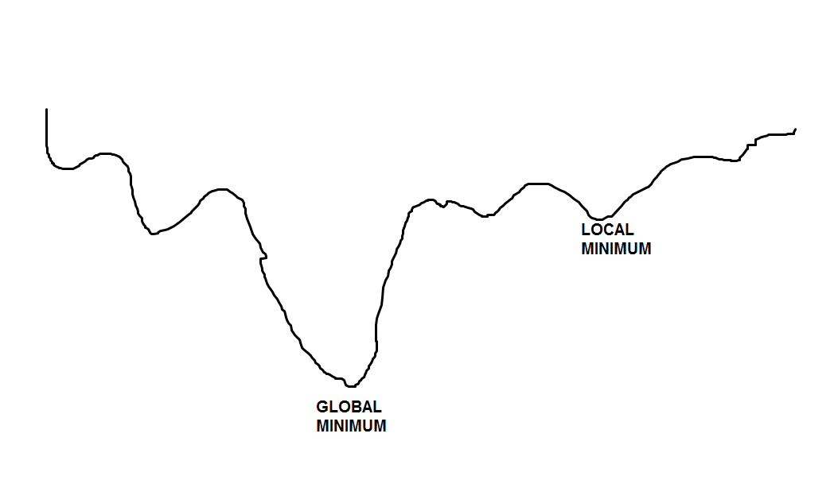
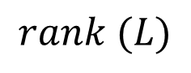
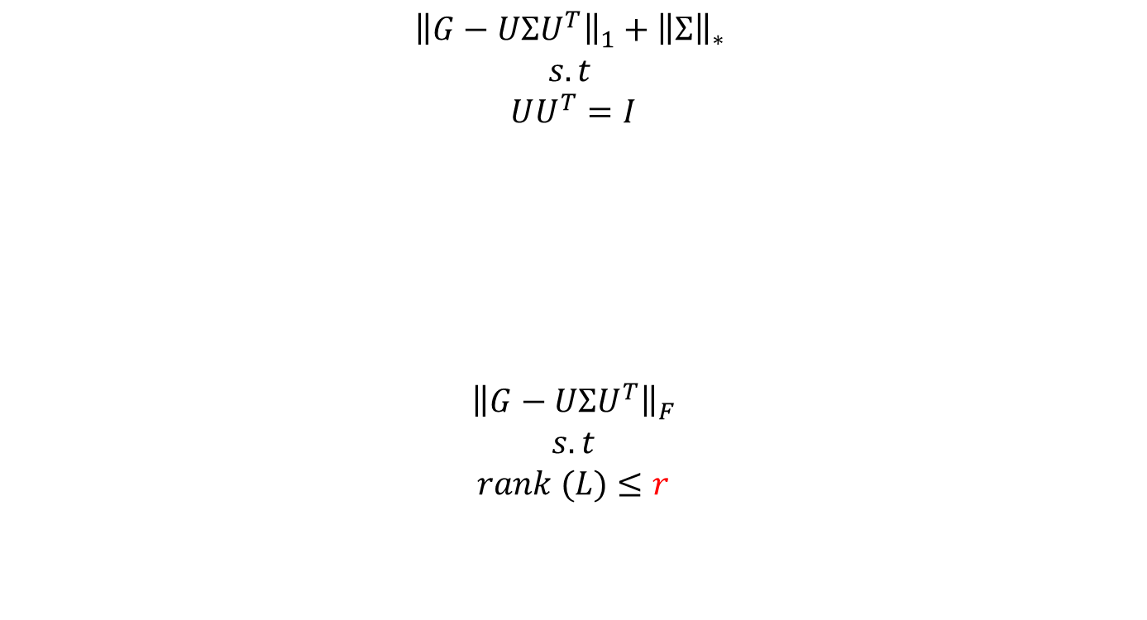
Proposed Method for the Covariance Matrix Update in GPR
$${\left\|G−UΣU^{T}\right\|}_{1}+{\left\|Σ\right\|}_{∗}$$
$$s.t$$
$$UU^{T}=I$$
$${\left\|G−UΣU^{T}\right\|}_{F}$$
$$s.t$$
$$rank (L)≤r$$
Convex Relaxed Low rank
Approximation or Mean square error regularized
Initialization
$$rank (L)$$
Nonconvex Low Rank
Approximation
I first compute rank (L) using convex relaxed low-rank approximation and used
to initialize nonconvex low-rank approximation

Slide 11
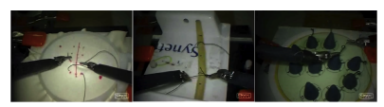
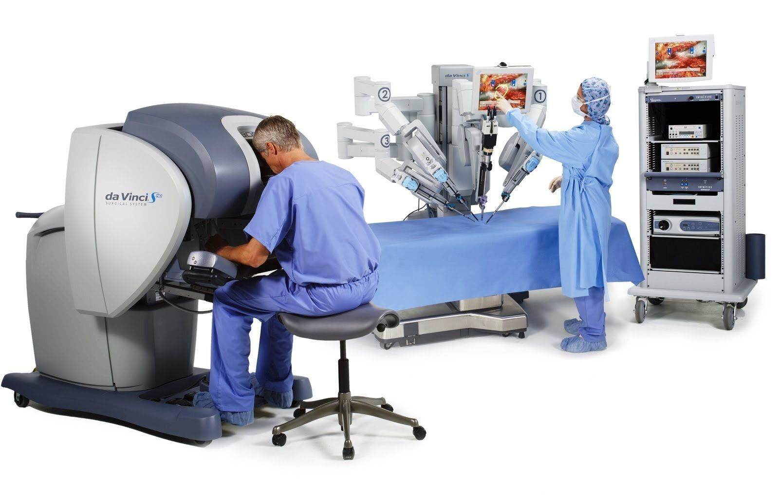
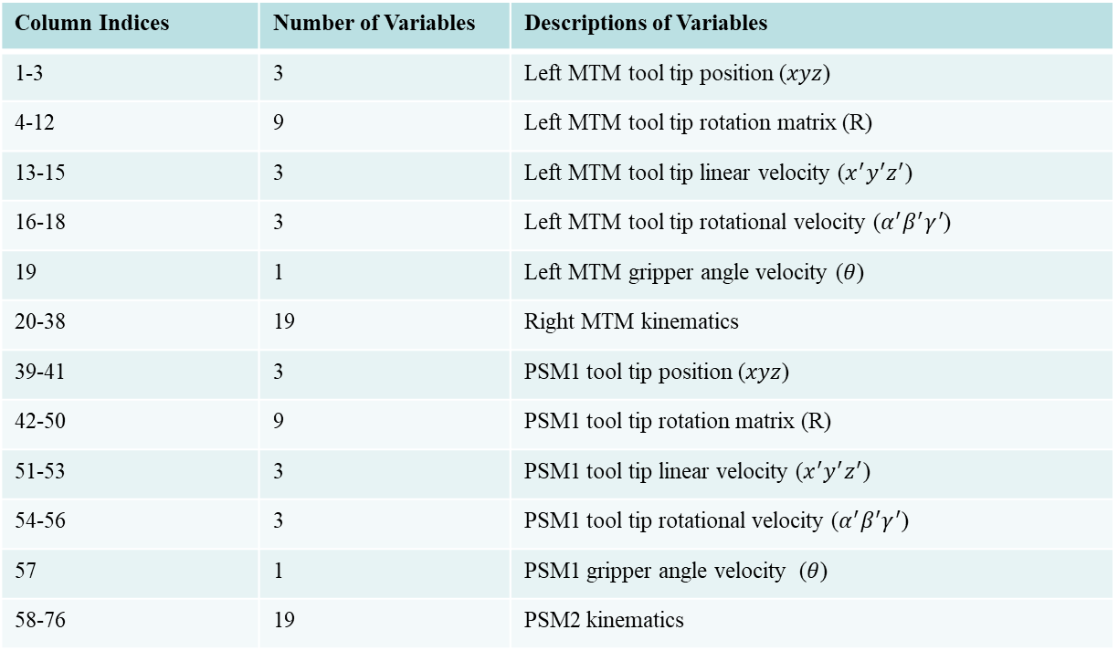
Kinematic Dataset of Surgical Task
Suturing
Knot-Tying
Needle passing
Column Indices | Number of Variables | Descriptions of Variables
1-3 | 3 | Left MTM tool tip position ($xyz$)
4-12 | 9 | Left MTM tool tip rotation matrix (R)
13-15 | 3 | Left MTM tool tip linear velocity ($x^{′}y^{′}z^{′}$)
16-18 | 3 | Left MTM tool tip rotational velocity ($α^{′}β^{′}γ^{′}$)
19 | 1 | Left MTM gripper angle velocity ($θ$)
20-38 | 19 | Right MTM kinematics
39-41 | 3 | PSM1 tool tip position ($xyz$)
42-50 | 9 | PSM1 tool tip rotation matrix (R)
51-53 | 3 | PSM1 tool tip linear velocity ($x^{′}y^{′}z^{′}$)
54-56 | 3 | PSM1 tool tip rotational velocity ($α^{′}β^{′}γ^{′}$)
57 | 1 | PSM1 gripper angle velocity ($θ$)
58-76 | 19 | PSM2 kinematics
I split the dataset into 90% training and 10% testing data
Gao, Yixin, et al. "Jhu-isi gesture and skill assessment working set (jigsaws): A surgical activity dataset for human motion modeling." MICCAI workshop: M2cai. Vol. 3. No. 2014. 2014.

Slide 12
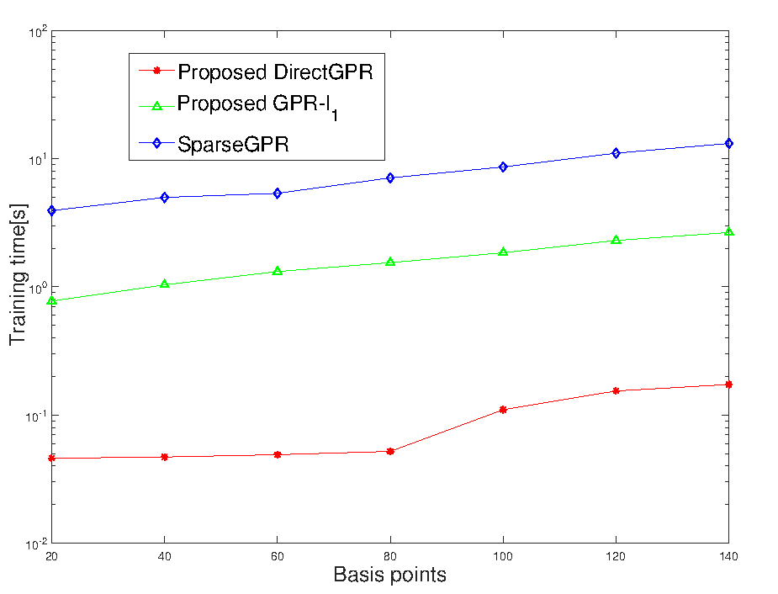
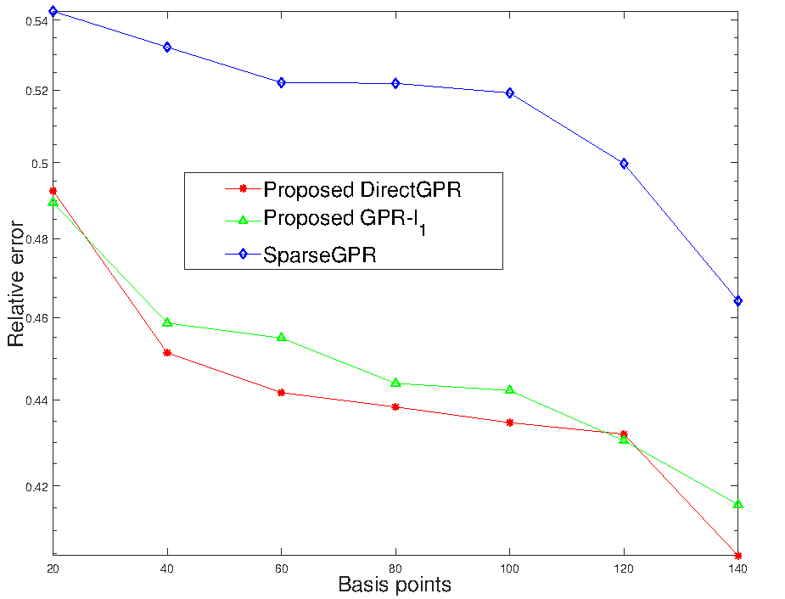
Evaluation (Knot-Tying Task)

Slide 13
Evaluation
I use haptic traces of different surgical tasks. We incorporated packet loss rates of 10^-4, 10^-3, 10^-2, and 10^-1 obtained after 50 haptic sessions into the original datasets to represent the estimated randomly lost haptic sample.
.
Francis Boabang, A. Ebrahimzadeh, R. Glitho, H. Elbiaze, M. Maier and F. Belqami, "A Machine Learning Framework for Handling Delayed/Lost Packets in Tactile Internet Remote Robotic Surgery," in IEEE Transactions on Network and Service Management, doi: 10.1109/TNSM.2021.3106577

Slide 14
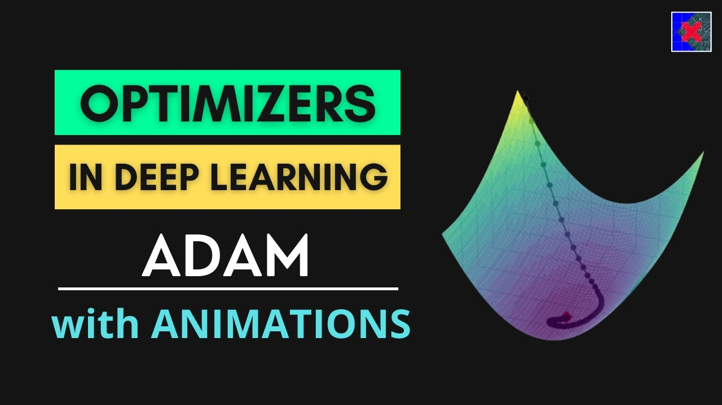
Francis. Boabang, Enhanced Stochastic Gradient Descent Algorithm for Machine Learning Training and Its Application in Remote Surgical Gesture Recognition, (Under Review in IEEE Transaction on Neural Network and Learning Systems)

Slide 15
A Review of Stochastic Gradient Descent (SGD)
Stochastic gradient descent uses the same learning rate for all the coordinates
Adaptive stochastic gradient descent uses different effective learning rate for different coordinates
The idea is to propose a new adaptive learning rate to learn the varying stepsize for different coordinates
Each coordinate has it own learning rate
Examples of adaptive stochastic gradient descent
ADAGRAD – Conventional adaptive stochastic gradient descent
ADAM- Adaptive Moment Estimation [1]
PADAM-Partial Adaptive Moment Estimation
[1] Kingma, Diederik P., and Jimmy Ba. "Adam: A method for stochastic optimization." arXiv preprint arXiv:1412.6980 (2014).
Zaheer, Manzil, et al. "Adaptive methods for nonconvex optimization." Advances in Neural Information
Processing Systems. 2018.

Slide 16
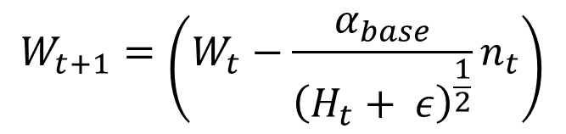
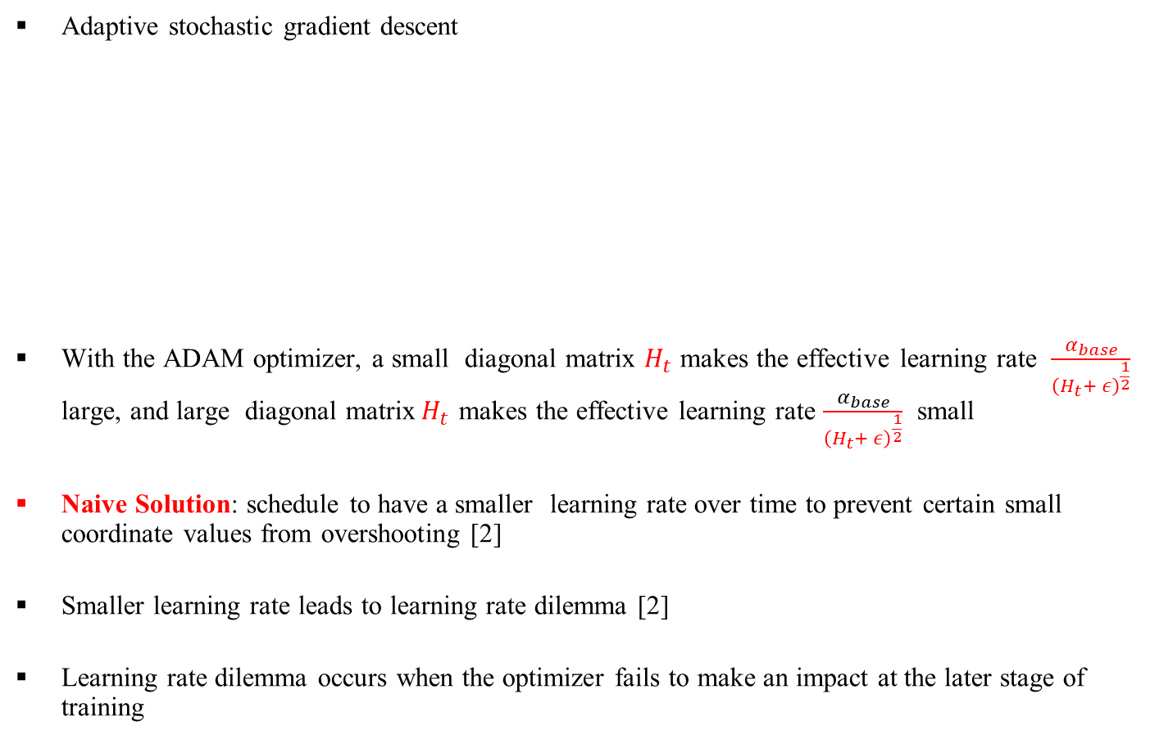
A Review of Adaptive Stochastic Gradient Descent
Adaptive stochastic gradient descent
With the ADAM optimizer, a small diagonal matrix $H_{t}$ makes the effective learning rate $\frac{α_{base}}{{\left(H_{t}+ ε\right)}^{\frac{1}{2}}}$ large, and large diagonal matrix${ H}_{t}$ makes the effective learning rate $\frac{α_{base}}{{\left(H_{t}+ ε\right)}^{\frac{1}{2}}}$ small
Naive Solution: schedule to have a smaller learning rate over time to prevent certain small coordinate values from overshooting [2]
Smaller learning rate leads to learning rate dilemma [2]
Learning rate dilemma occurs when the optimizer fails to make an impact at the later stage of training
Adaptive Moment Estimation(ADAM)
$$W_{t+1}=\left(W_{t}−\frac{α_{base}}{{\left(H_{t}+ ε\right)}^{\frac{1}{2}}}n_{t}\right)$$
[2] Chen J, Zhou D, Tang Y, Yang Z, Cao Y, Gu Q. Closing the generalization gap of adaptive gradient methods in training deep neural networks. arXiv preprint arXiv:1806.06763. 2018 Jun 18.

Slide 17
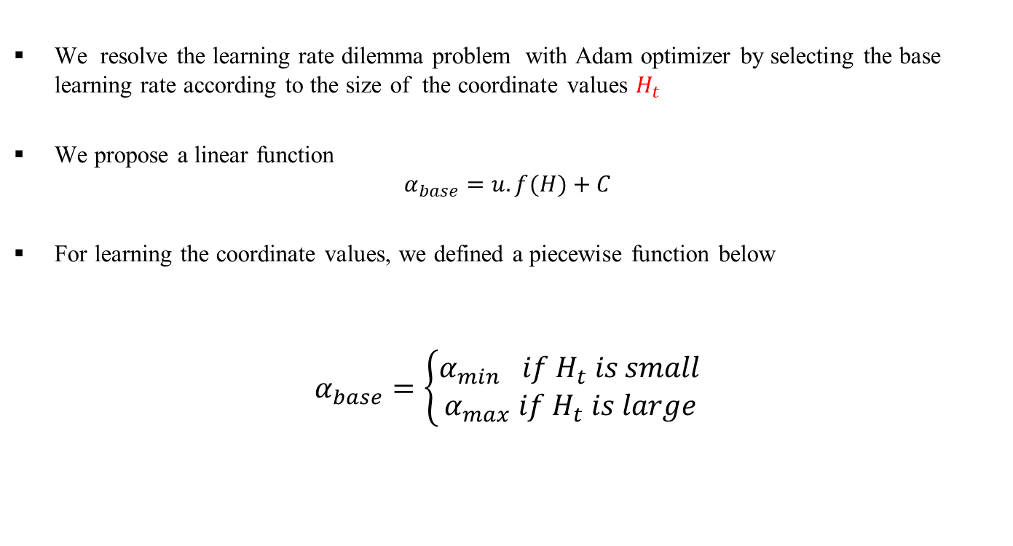
Proposed Adaptive Stochastic Gradient Descent Algorithm
We resolve the learning rate dilemma problem with Adam optimizer by selecting the base learning rate according to the size of the coordinate values $H_{t}$
We propose a linear function
$$α_{base}=u.f(H)+C$$
For learning the coordinate values, we defined a piecewise function below
$$α_{base}=\left\{\begin{aligned}α_{min} if H_{t} is small \\ α_{max} if H_{t} is large\end{aligned}\right.$$
Piecewise function for base learning rate selection

Slide 18
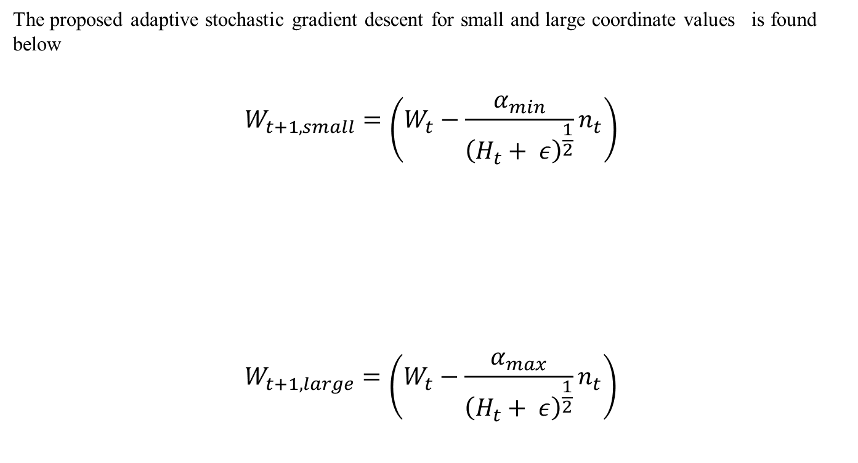
Proposed Adaptive Stochastic Gradient Descent
The proposed adaptive stochastic gradient descent for small and large coordinate values is found below
$$W_{t+1,small}=\left(W_{t}−\frac{α_{min}}{{\left(H_{t}+ ε\right)}^{\frac{1}{2}}}n_{t}\right)$$
$$W_{t+1,large}=\left(W_{t}−{\frac{α_{max}}{{\left(H_{t}+ ε\right)}^{\frac{1}{2}}}n}_{t}\right)$$
Small coordinate values update rule
Large coordinate values update rule

Slide 19
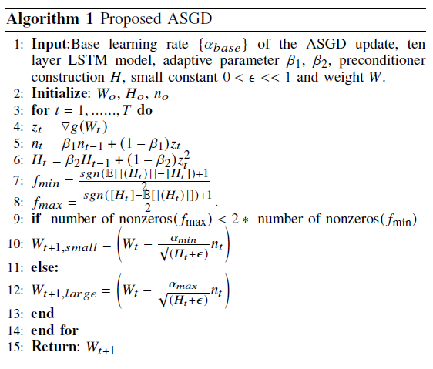
Proposed Algorithm (Improved Adam/Amsgrad)
Contribution : Select large
or small coordinate values
update rule

Slide 20
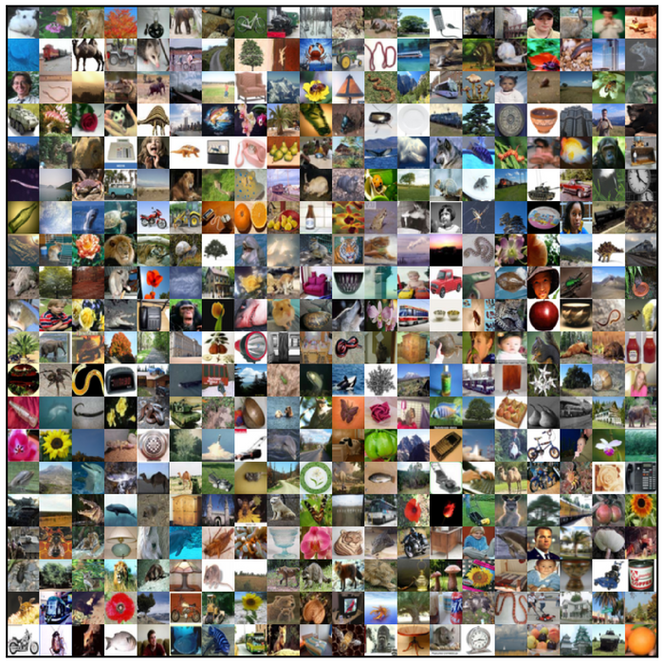
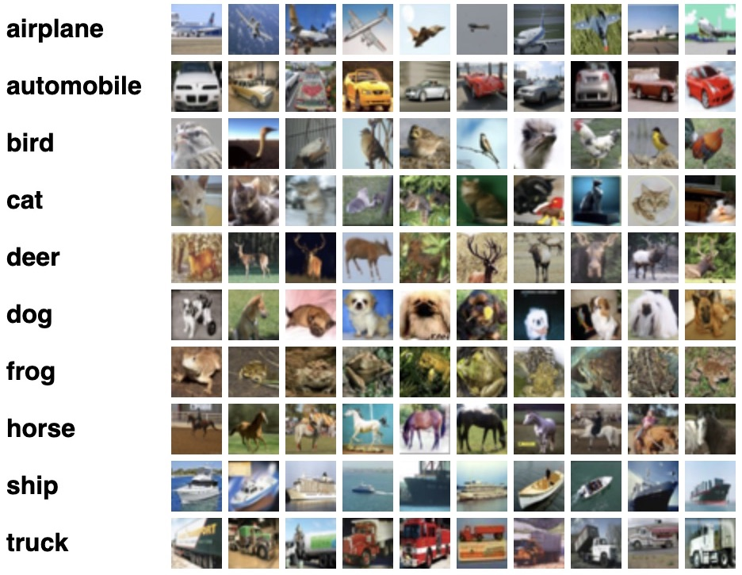
CIFAR-100 Image Dataset
500 training images per class
100 testing images per class
100 classes
20 Super classes with 5 Subclasses

Slide 21
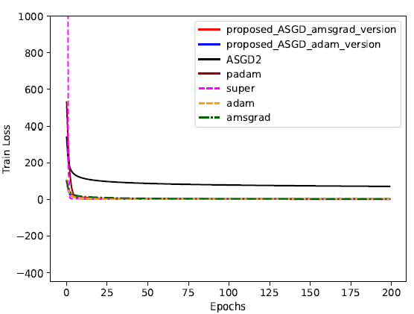
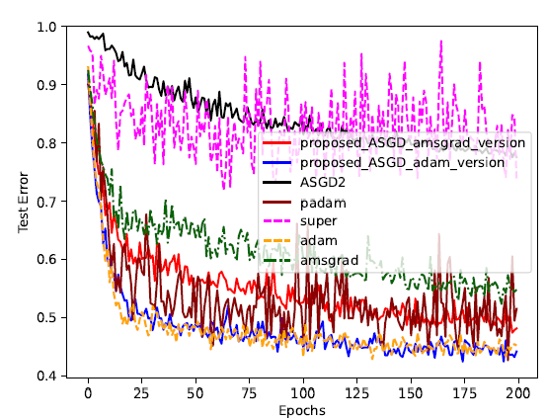
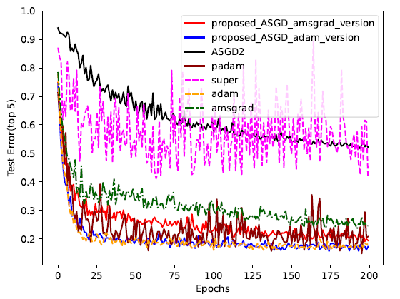
Image Classification Experiment (WideResNet with Batch 64)

Slide 22
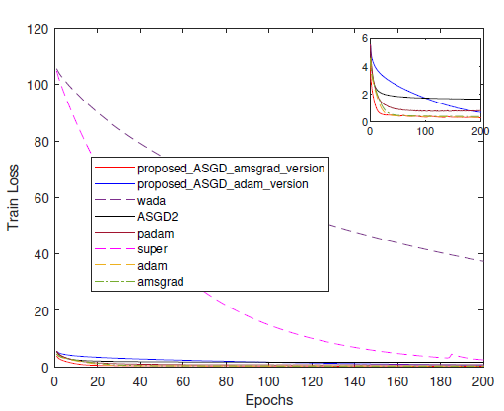
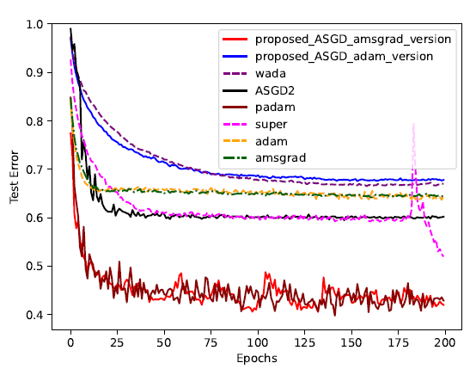
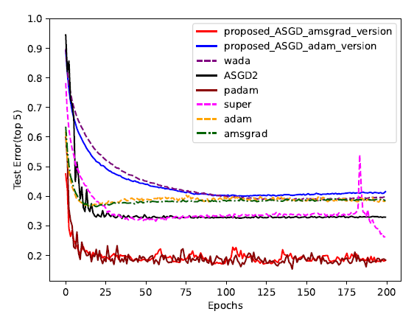
Image Classification Experiment (VGG16-Net with Batch 64)

Slide 23
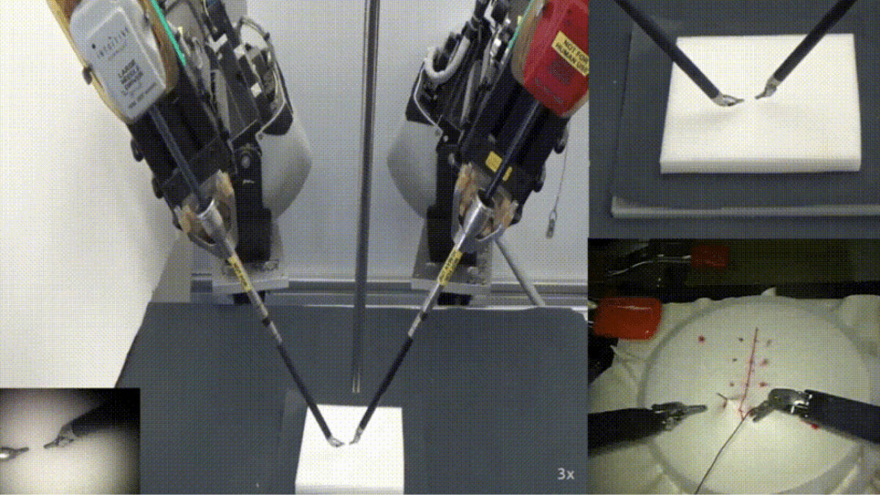
Suturing Video Dataset
Gestures | Vocabulary
y1 | Reaching for needle with right hand
y2 | Positioning needle
y3 | Pushing needle through tissue
y4 | Transferring needle from left to right
y5 | Moving to center with needle in grip
y6 | Pulling suture with left hand
y8 | Orienting needle
y9 | Using right hand to help tighten suture
y10 | Loosening more suture
y11 | Dropping suture and moving to end points
Gestures: y1, y2, y3, y4, y5, y6, y8, y9, y10,y11
Less frequently occurring gestures: y1, y5, y8, y9, y10
We split the dataset into 90% training and 10% testing data
Gao, Yixin, et al. "Jhu-isi gesture and skill assessment working set (jigsaws): A surgical activity dataset for human motion modeling." MICCAI workshop: M2cai. Vol. 3. No. 2014. 2014.

Slide 24
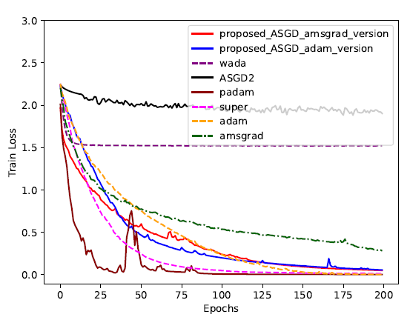
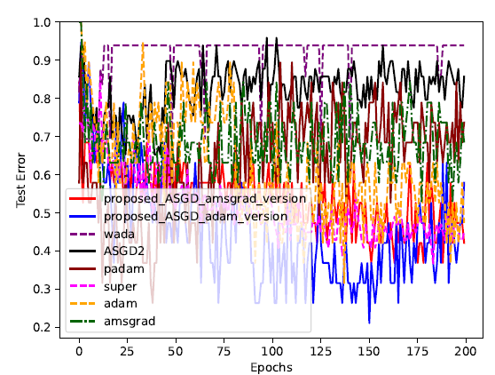
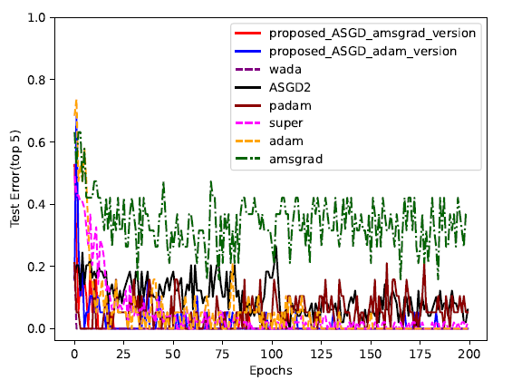
Remote Surgical Gesture Recognition (2D CNN LSTM)

Slide 25
Conclusion of the Thesis
The proposed approach performs best by using a convex low-rank matrix factorization as the starting point for the nonconvex method
The proposed ASGD method achieved the optimal outcome due to our approach to
addressing the small learning rate dilemma problem
Model compression makes factorized updates to weight or covariance matrices more efficient, while ASGD is effective but costly for unfactorized updates
Combining ASGD with model compression enables factorized updates, boosting efficiency and performance for machine learning models in tactile internet applications

Slide 26
Limitations
A predefined number of iterations alternates between convex relaxed low-rank matrix factorization and nonconvex low-rank matrix factorization to scale machine learning
The proposed ASGD algorithm cannot automatically adjust the maximum second-order momentum matrix between deep and shallow learning models, affecting remote robotic surgery performance.
The proposed ASGD does not address the class imbalance in the JIGSAW robotic surgery dataset
The limited availability of publicly accessible robotic surgery data for training the model has impeded our ability to pinpoint limitations in the algorithm for future enhancement

Slide 27
Future Work
Combine sparse GPs with nonconvex regularization and efficient convex preserving strategies
to improve predictive performance
Expand the base learning selection strategy to other models, such as Adabrief, to assess performance
in strongly convex settings
Evaluate the proposed ASGD across various neural networks
Deploy the proposed ASGD and low-rank factorization algorithm on Mobile Edge Computing (MEC) to address latency issues.

Slide 28
Thesis-Inspired Optimization Methods for Variational Quantum Algorithms
Francis Boabang
28
Notes:
Proactive prediction for haptic feedback in remote robotic surgery
Introduction
Remote Robotic Surgery (including overlapping surgery)
Haptic Feedback Prediction
Proactive Prediction
Related Work
Evaluation

Slide 29
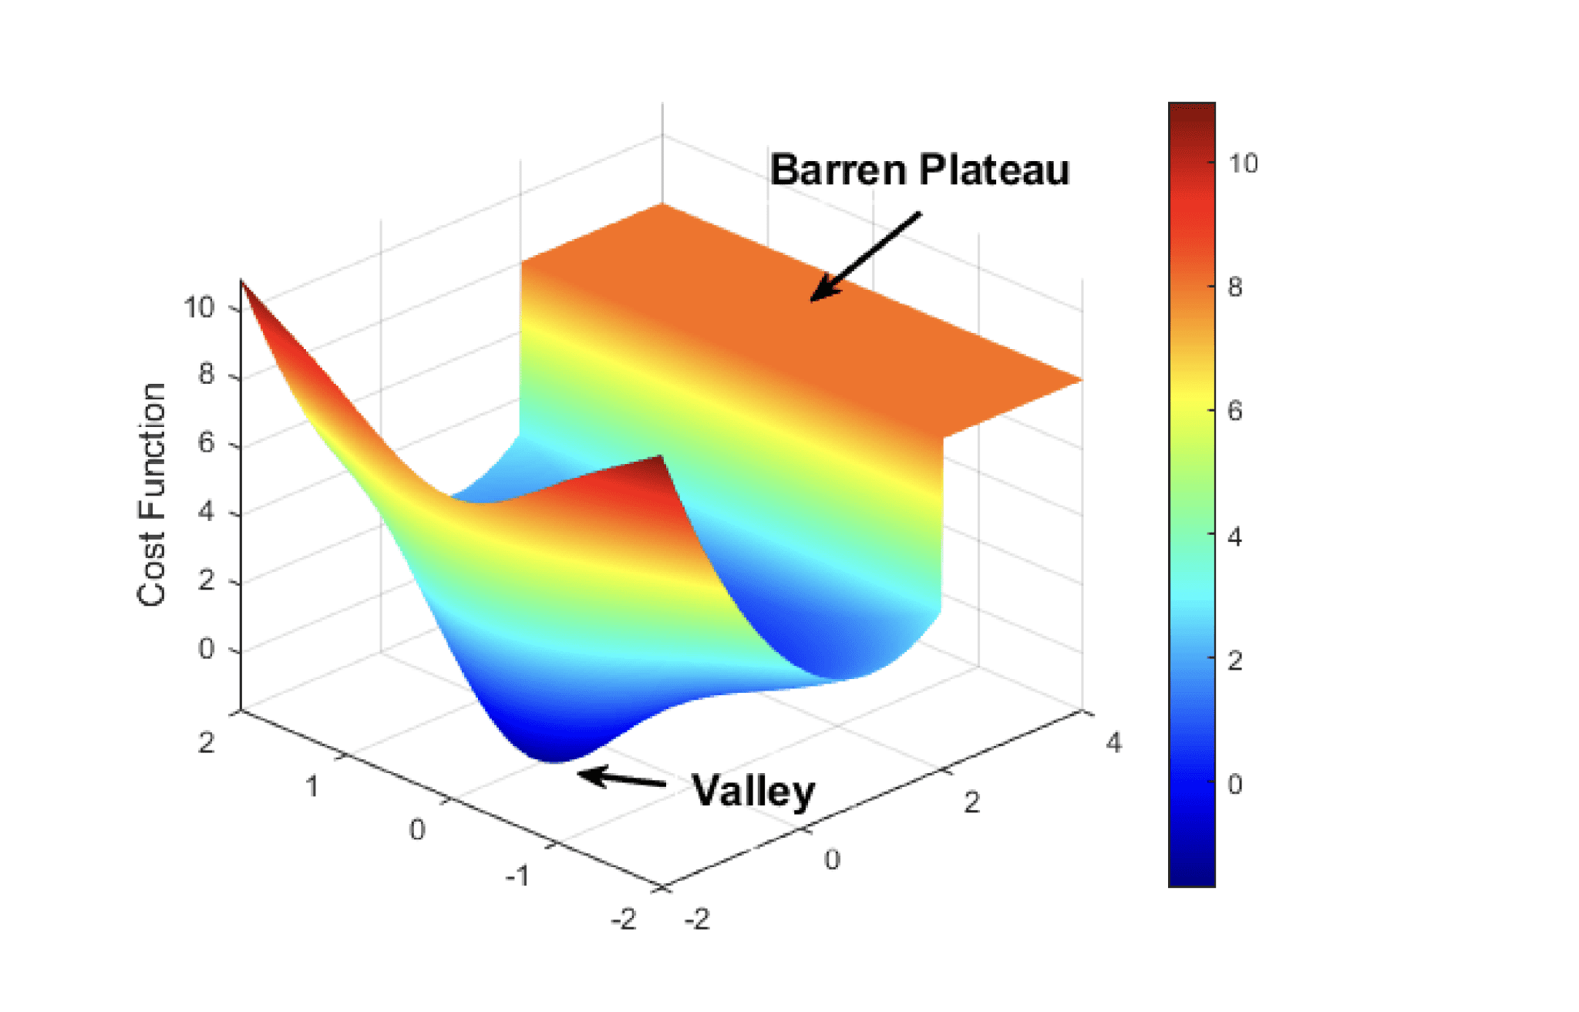
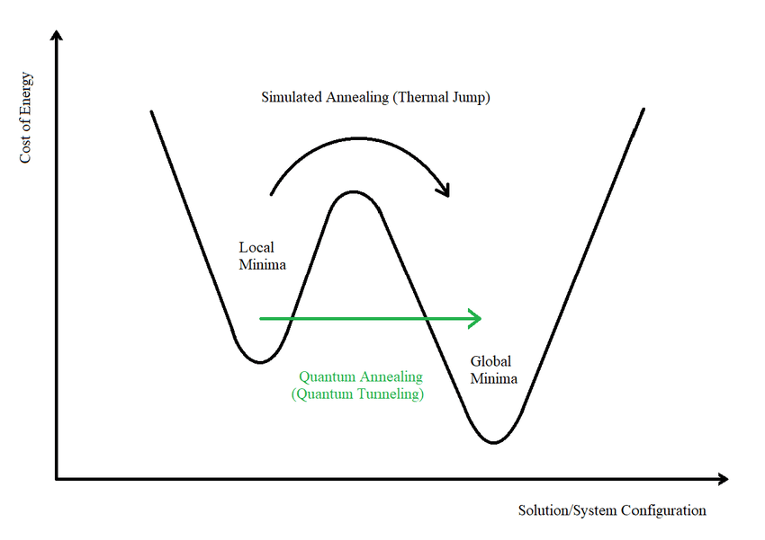
Motivation: Quantum Variational algorithms
Quantum variational algorithms (e.g., QAOA, VQE) often suffer from barren plateaus, where gradients vanish, hindering training and convergence.
In the Hamilton landscape, saddle points are regions where gradients vanish but curvature changes direction flat along one dimension and steep along another. They represent unstable equilibria that can trap optimizers between minima and maxima, slowing or halting convergence.
Quantum variational algorithms can mitigate this by preserving gradient flow through structured initialization.
Stęchły, Michał. "Introduction to variational quantum algorithms." arXiv preprint arXiv:2402.15879 (2024).

Slide 30
Escaping Poor minima in Hilmaton Landscape Using Research Insights from Slides 9 and 10
Convex Initialization Stage:
Initializes the Hilmaton (quantum landscape) using a convex surrogate loss or landscape
to find a smooth, low-energy region. Prevents random initialization collapse and stabilizes
early optimization.
Nonconvex Refinement Stage:
Introduces structured oscillations in the in the Hilmaton landscape.
Enables fine-grained adaptation and better exploration of quantum states.

Slide 31
Quantum Aware Optimizer for Navigating Barren/Hamilton Landscape: Using Research Insights from Slides 17, 18, and 19
Taking insights from slides 18, 19 and 20, we can propose a quantum aware optimizer that can adjust the base learning rate according to the size of the coordinate values to help the variational quantum algorithm escape local optima and converge to a good solution in barren landscape.
Also, we can modify the switching mechanism in slides 18, 19 and 20, to improve the quantum aware optimizer navigation in the Hamilton landscape via curvature aware navigation, improving convergence and generalization.

Slide 32
Thank you

